Slide 1

Energy and Environment Laboratory
Vivek Kumar
Professor
CRDT, IIT Delhi

Slide 2
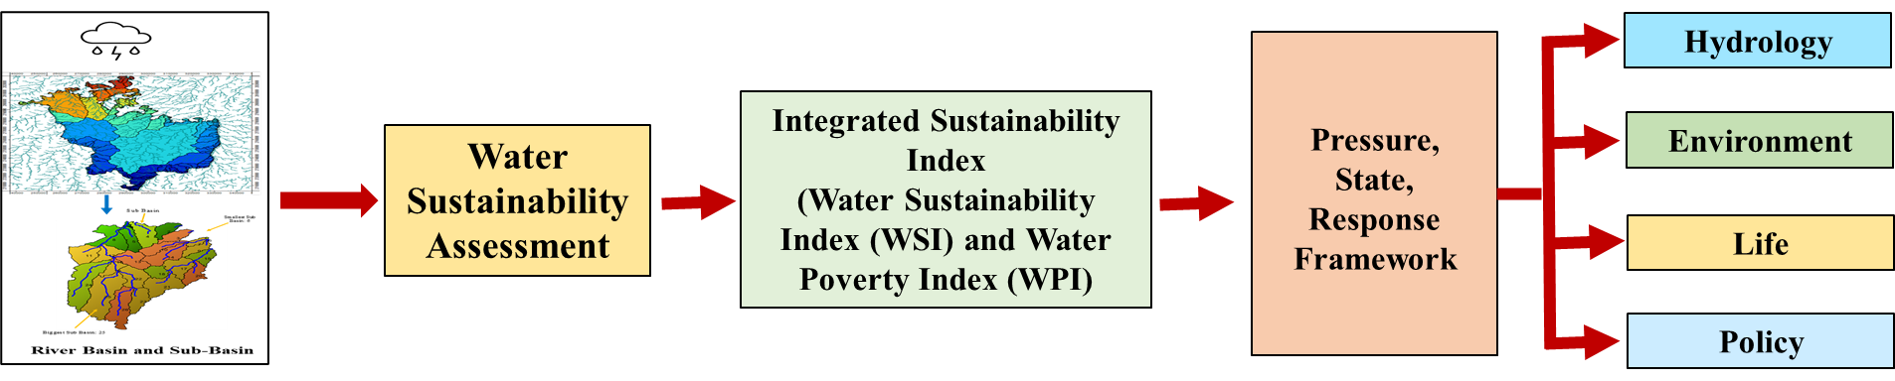
Multidimensional Sustainability Framework for Technology Assessment and Development of Decision Support System of Basins
Decision Support System for Liquid Waste Management in Rural Areas
Identification of study area and field survey
Data analysis
Selection of Technology
Assessment of Technology through Sustainability analysis and LCA
Decision support system

Slide 3
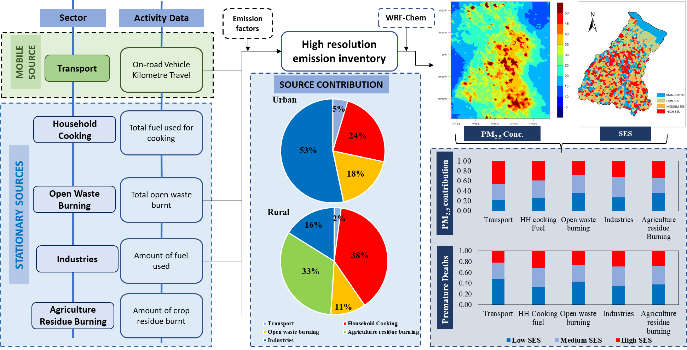
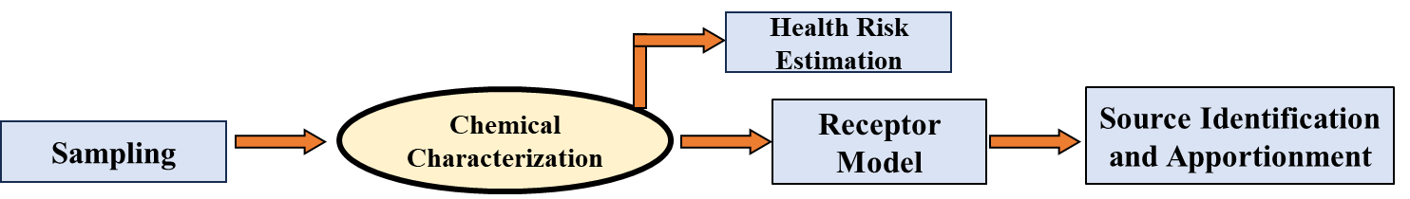
Source Identification, Characterization and Risk Assessment of Pollutants

Slide 4

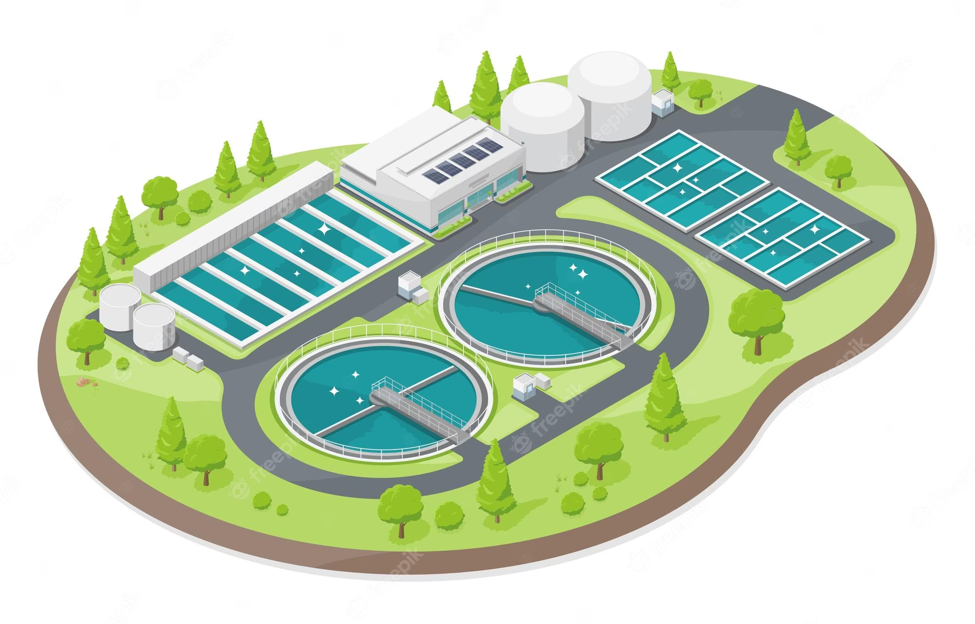


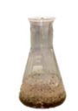
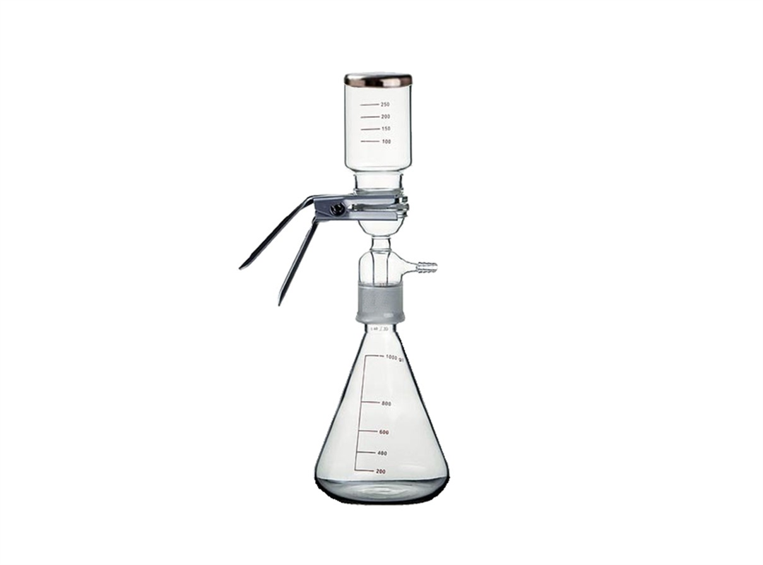
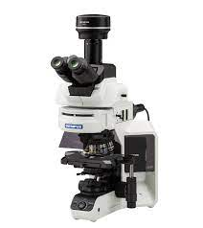
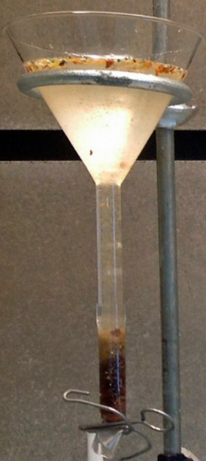
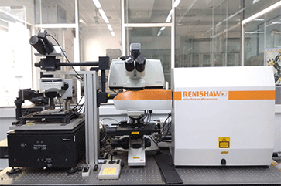
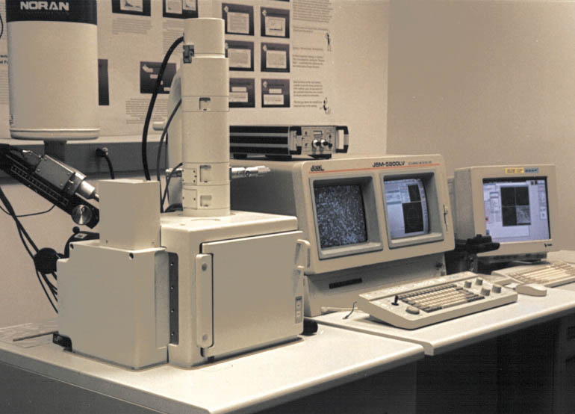


Source Identification, characterization and Risk assessment of Pollutants
1. Extraction, identification and characterization of Microplastics from different environmental matrices
WASTEWATER SAMPLES
SEDIMENT, COMPOST, AND SOIL SAMPLES
Influent
Effluent
Municipal solid waste compost
Sludge
Pond Sediments
MPs EXTRACTION AND SEPARATION
MPs CHARACTERIZATION TECHNIQUES
Vacuum filtration (0.22 µm membrane filter)
Microscope
(Size, shape, and color)
Organic digestion
Inorganic removal
µ-Raman spectroscopy
(Chemical nature)
SEM-EDX
(Micromorphology)
2. Ecological risk assessment and characterization
3. Microplastics mitigation strategies
Development of Anaerobic and aerobic microbial consortium for MPs removal

Slide 5
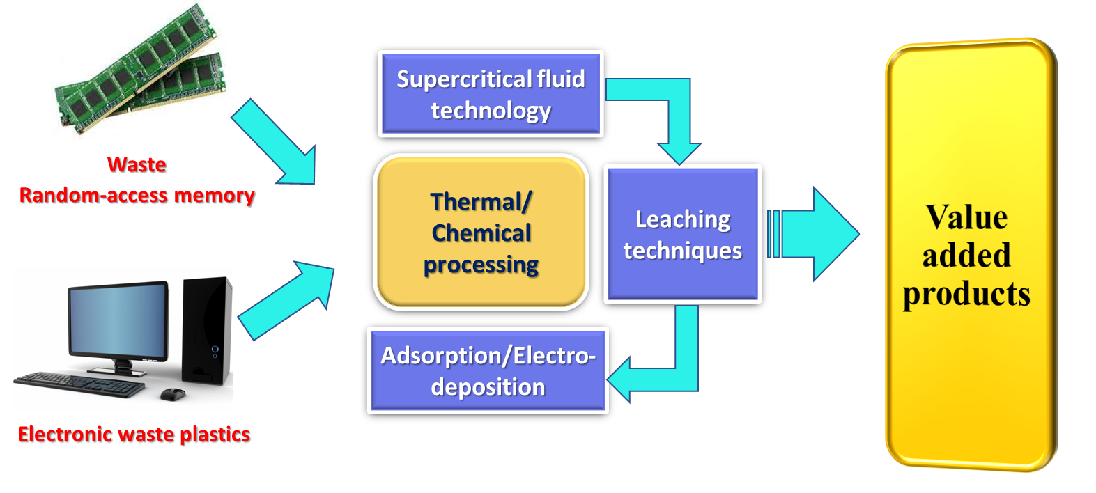
Waste Recycling and Valorisation
E-Waste recycling and valorisation

Slide 6
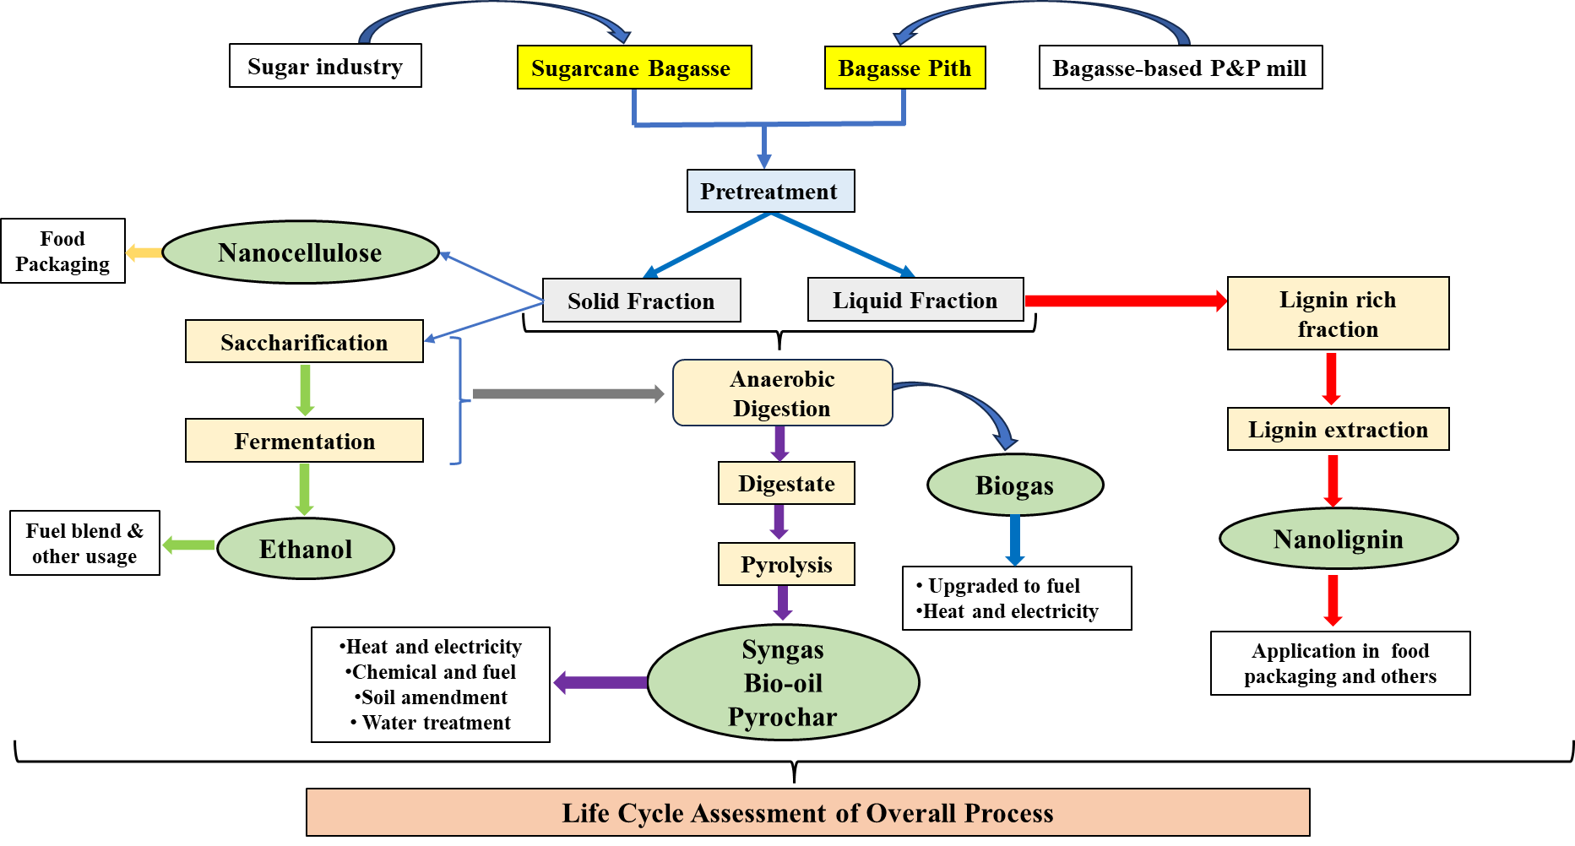
Waste Recycling and Valorisation
Valorization of waste from sugarcane industry and pulp and paper mill through Green Processes

Slide 7
Thank You

